Slide 1
NE 763: Advanced Reactor Materials
Fall 2025
Dr. Benjamin Beeler

Slide 2
Last Time
Wrapped up HEAs and then went through Ni alloys
Ni alloys…
FCC, excellent high T behavior, often precipitation hardened, suffer from He embrittlement, dose-dependent effects on mechanical properties
Research Reactor fuels, what are some key features:
low temperatures, no gap or plenum, high burnup
Primary type is dispersed particles of metallic compound/alloy in a fuel block embedded in Al matrix; key features often include solid/gaseous swelling, interaction layer growth, and amorphization
UAlx
mix of UAl2, UAl3, UAl4; very little gas swelling; all phases go amorphous; interaction layer is simply Al-rich U-Al phases

Slide 3
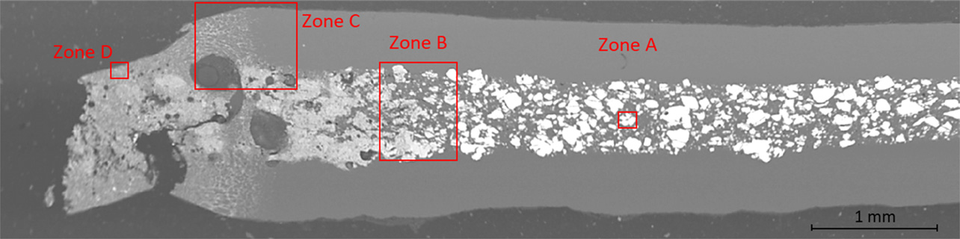
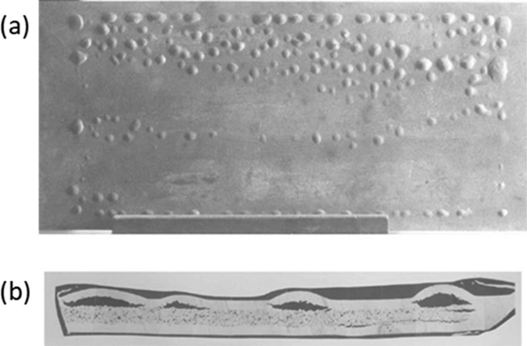
Off-normal behavior
Most common accident scenario is a channel blockage, resulting in loss of coolant flow
In the extreme, this can lead to fuel melting
Higher temperatures at a minimum will lead to bubble formation, coalescence, and swelling
Temperature increases can result in the blistering of the plates, a delamination of the cladding from the fuel, and potential burst of cladding and release of fission products

Slide 4
U-Al Summary
UAlx fuels are in dispersion form in an aluminum matrix
The three uranium aluminides undergo amorphization depending on the fission rate and temperature
UAl4 amorphizes most readily and UAl2 least readily
UAlx–Al dispersions have lower fueled zone swelling than any other type fuel dispersions due to low fission gas bubble swelling
UAlx fuels had limited utilization due to the requirement of very high U enrichment in relatively low U density alloys
Additionally, UAl2 is highly pyrophoric, leading to difficulties in fabrication, significantly increasing costs

Slide 5
RERTR
The US DOE initiated the RERTR (Reduced Enrichment for Research and Test Reactors) program in 1978 to convert the world’s research and test reactors using high-enrichment uranium (HEU) to those using low-enrichment uranium (LEU)
An enrichment in 235U of 20 at.% is the threshold between HEU and LEU
Reactors were/are using mainly UAlx and U3O8 dispersion fuels
To use a fuel with reduced enrichment while keeping the fuel phase volume the same in the fueled zone requires using a fuel with a higher uranium density to compensate for the reduced fissile fraction in LEU
The fuel form developed to accomplish this is U3Si2, which allows for much higher fissile density than UAlx

Slide 6
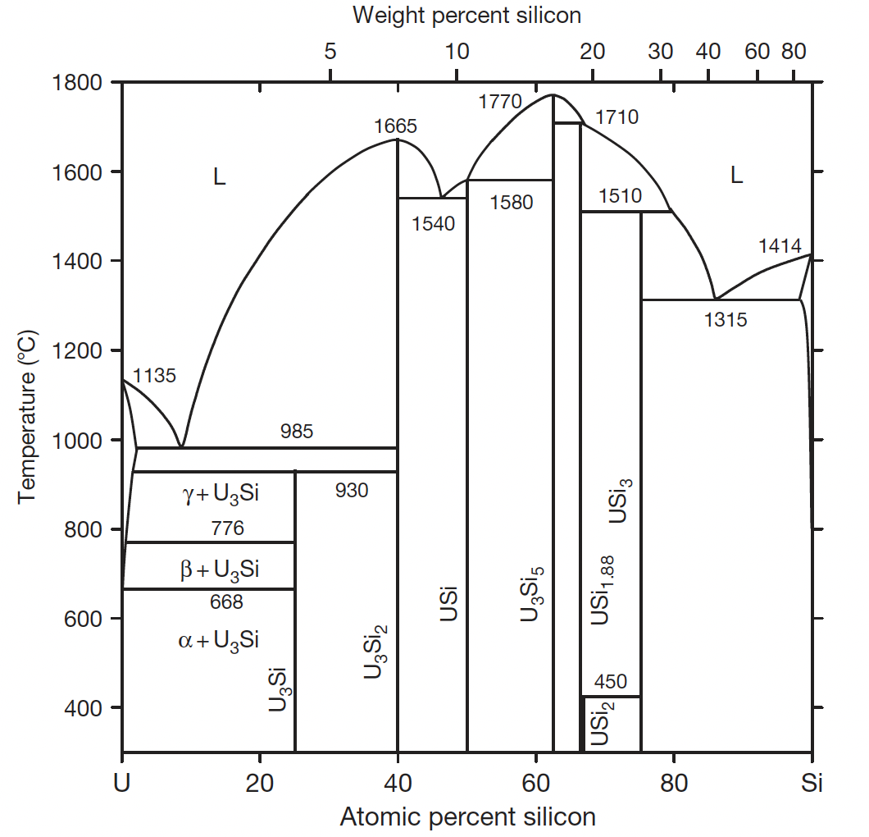
U-Si
In the U-Si system, U3Si, U3Si2, and USi are the compounds of interest for candidate fuels chiefly because of their high uranium density: 15.3, 12.2, and 10.96 g/cc, respectively
U3Si2 and USi form directly from liquid, but U3Si forms only by a peritectoid reaction at 925C
U3Si and U3Si2 are of key interest, due to their higher U density
U3Si2 is also of some interest in commercial LWR application

Slide 7
U-Si Fabrication
In practice, it is almost impossible to fabricate the exact stoichiometric form of one of these U-Si compounds
Typically, a higher content of Si is required to suppress the formation of solid solution U, or excessive Si-lean U-Si compounds
The secondary phases typically reside inhomogeneously in a fuel particle, which causes inhomogeneous size distributions of fission gas bubbles inside the fuel particles
Alloy ingots of U–Si are made by mixing and melting of uranium and silicon with a desired Si/U ratio
The ingots are sometimes annealed in an inert atmosphere to complete compound formation
These ingots are then broken into smaller particles by a powder fabrication process
U3Si is more ductile than U3Si2, and requires significantly more work to break into small particles

Slide 8
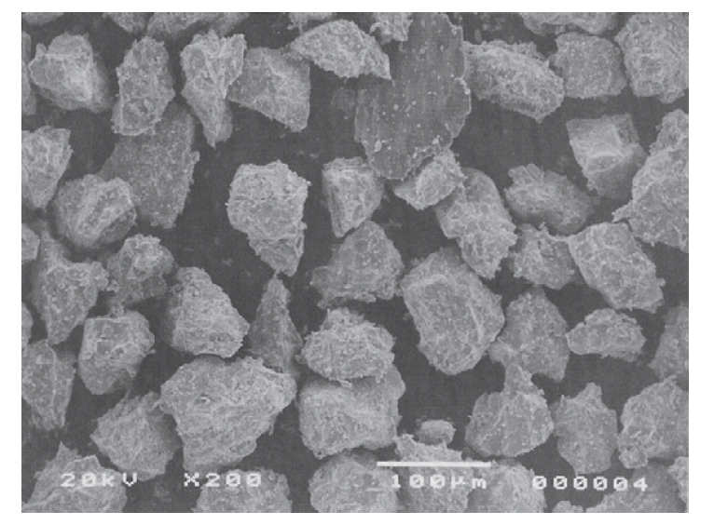
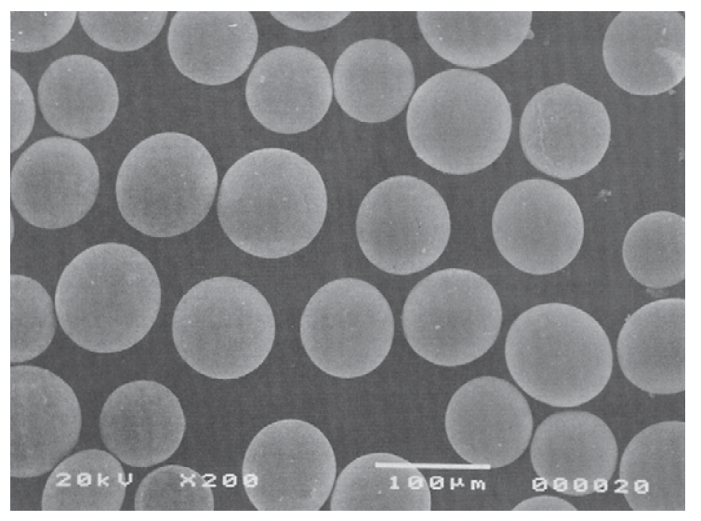
U-Si Fabrication
The fragmentation/comminution process results in jagged and irregular powders
An atomization technology widely used in powder metallurgy is applied to fabricate spherical powders of U3Si2 and U3Si, involving liquid fuel droplets and centrifugal force
Atomized powder has several advantages over comminuted powder: 1) surface-to-volume ratio is smaller, so reaction with matrix is less; 2) high homogeneity and fewer impurities; 3) lower residual stresses and defects
Comminution
Atomization

Slide 9
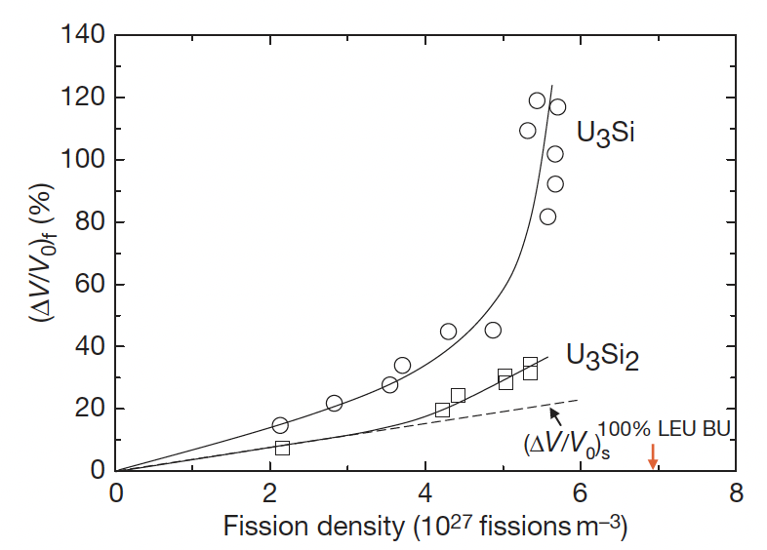
U-Si Fuel Swelling
Solid fission product swelling is treated as identical to that in UAlx fuels, but fission gas swelling is markedly different
Large swelling for U-Si phases, more so for U3Si
Fuel swelling kinetics of U–Si fuel particles is well documented in the literature
Again, gaseous swelling is estimated by subtracting solid FP swelling from the total swelling

Slide 10
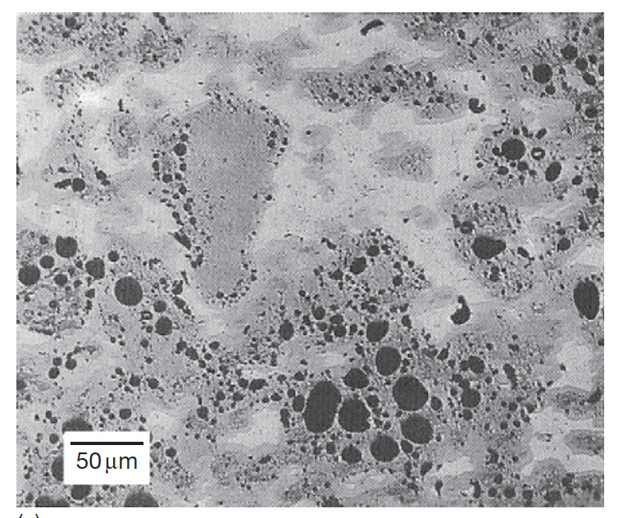
Amorphous Swelling
U3Si and U3Si2 are known to become amorphous under irradiation at sufficiently low temperatures
The primary damage in the crystal is due to highly energetic fission fragments
In the amorphous fuel, fuel swelling depends on the viscosity of fuel
Fission gas mobility is also high in the amorphous material and the fuel is more readily deformed by the growing gas bubbles
U3Si fission gas bubbles at 4.5E27 f/m3

Slide 11
U-Si Swelling
Figures shows fuel microstructures and the fission gas bubble morphology of irradiated U3Si and U3Si2 at 100C to 15% and 19% burnup
U3Si
U3Si2

Slide 12
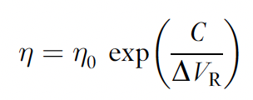
U-Si Swelling
Both U3Si and U3Si2 are amorphous during research reactor irradiation
Fission gas bubble growth in U3Si is high and unstable, while that of U3Si2 is generally lower and stable
An explanation is the correlation between free volume upon amorphization and viscosity, in that U3Si has larger free volume than U3Si2
U3Si viscosity is relatively lower due to larger volume change
The additional Si bonds in U3Si2 have a large effect on the amount of free volume in the glassy state, and therefore also on the fluidity of the fuel, and thus the swelling behavior
Amorphization is a prerequisite for this low-temperature high-swelling behavior

Slide 13
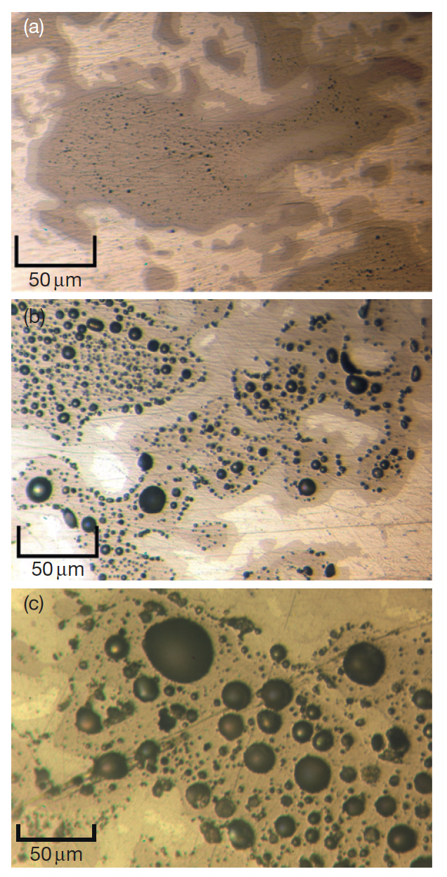
U3Si2 Swelling w/ temperature
The bubble morphology from higher temperature tests is available
Bubble growth in U3Si2 can be enhanced to the level of U3Si if the temperature is increased by about 60C (albeit at higher burnups)
It appears that the low bubble growth advantage of U3Si2 provided by the high Si/U ratio is negated if the temperature is increased
T=105 C and FD=3.2E27 f/m3
T=136 C and FD=5.4E27 f/m3
T=160 C and FD=6.1E27 f/m3

Slide 14
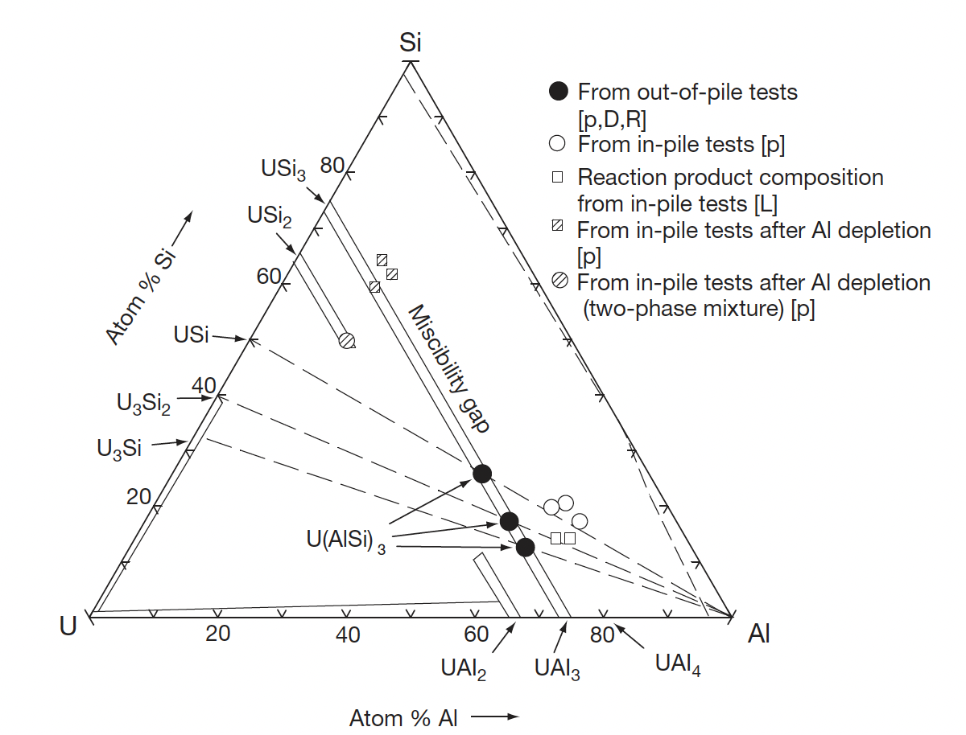
U-Si interaction with Al
U3Si, U3Si2, and USi react with Al to form a single intermetallic compound, U(AlSi)3
The solubility of Al in the USi phases is very low
U(AlSi)3 has a composition intermediate between UAl3 and USi3, both of which are mutually soluble

Slide 15
U-Si interaction with Al
Interaction layer growth is an interdiffusion controlled process, and can be investigated in out-of-pile experiments
Out-of-pile tests are typically performed at high temperatures (600C) and have shown that interdiffusion is the rate-controlling process in IL growth of U-Si-Al fuels
Fuel temperatures of typical in-pile tests are much lower (<200C) than the out-of-pile tests
Simple extrapolations to the low temperature regime of the IL growth correlations for out-of-pile tests yield orders of magnitude smaller IL thickness values than observed
This implies that thermally activated diffusion must be augmented by radiation-enhanced diffusion

Slide 16
U-Si interaction with Al
The compositions in the interaction layer deviate from the exact stoichiometry of U(AlSi)3
This indicates that the reaction products become amorphous during irradiation, which has been observed in in-pile tests
Since the IL is amorphous, U, Al, and Si atoms exist in a mixture without crystalline restriction of stoichiometry
The formation of gas bubbles in the ILs is important because of its potential effects on the IL growth rate
Gas bubbles in the IL could reduce the effective diffusion area and thereby reduce the IL growth rate, limiting breakaway IL formation

Slide 17
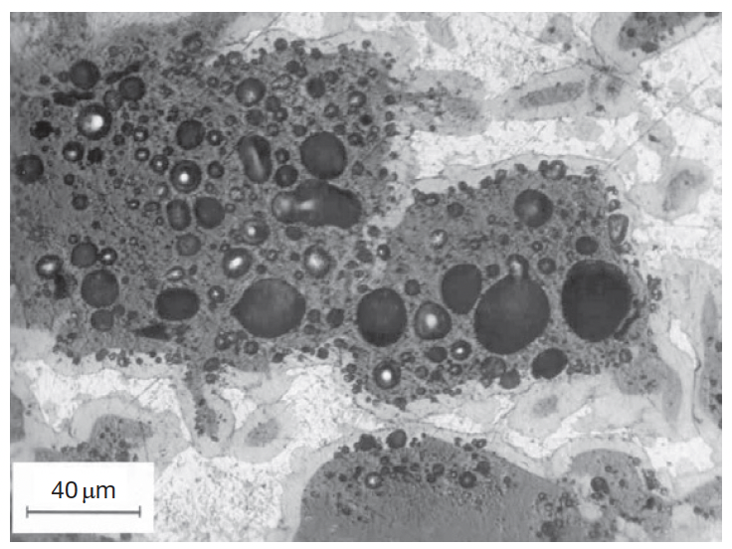
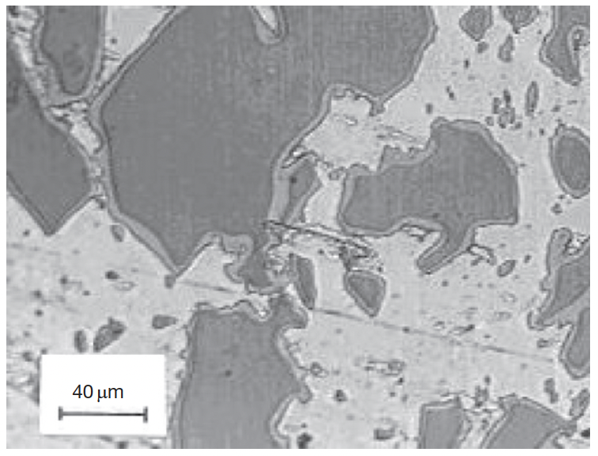
Micrographs of irradiated LEU U3Si–Al and U3Si2–Al
At low/medium burnup, the ILs of both fuels are generally uniform in thickness and free of visible fission gas bubbles
The gas bubbles in the unreacted fuel serve as a boundary between the unreacted fuel and the ILs
U3Si has dramatically higher swelling than U3Si2
Both samples have similar burnup and temperature
U3Si–Al
U3Si2–Al

Slide 18
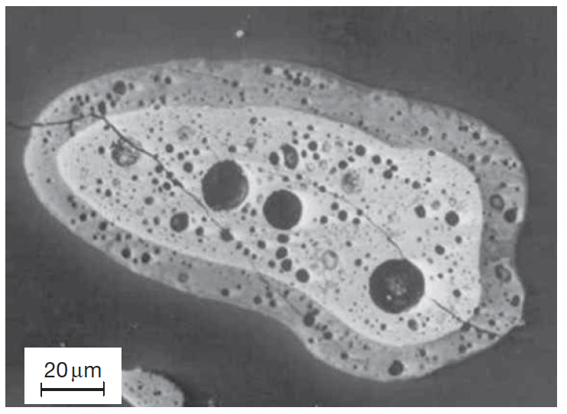
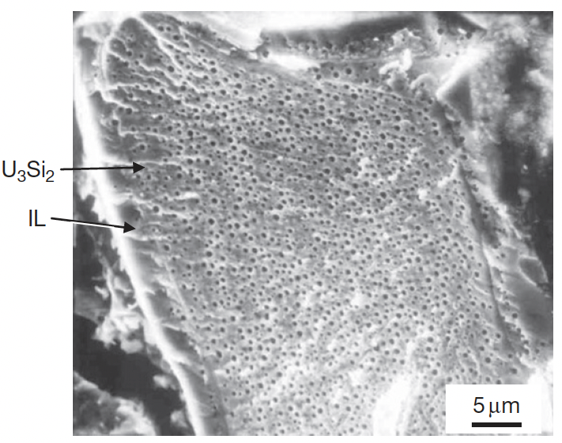
Micrographs of irradiated HEU U3Si–Al and U3Si2–Al
Gas bubbles are found in ILs of high-burnup HEU U-Si fuels
These images are from ultra high burnup samples, ~4.5X the previous slide
Thus, likely the formation of fission gas bubbles in the IL is dependent upon fission density
Bubbles in the IL of U3Si2 appear later than in U3Si
U3Si–Al
U3Si2–Al

Slide 19
Time for a break…
Questions on U-Si vs U3Si2?

Slide 20
Blister Testing
A unique measure for fuel performance in RTRs is ‘blister threshold temperature’ testing with irradiated plates
Because there is neither a gap nor a plenum, no fission gas release is possible outside of the fueled zone
Fission gas and any gas included during fabrication remain in the fueled zone; in particular, fission gases are contained in pores or fission gas bubbles
Gas pressure in large pores and fission gas bubbles, which may be insufficient to cause detrimental creep or yielding of fuel, could instead result in blistering of a fuel plate when the plate is heated to a certain temperature
Two types of mechanisms can be considered for blistering: pore (or void) connection, and pressure rupture of fission gas bubbles

Slide 21
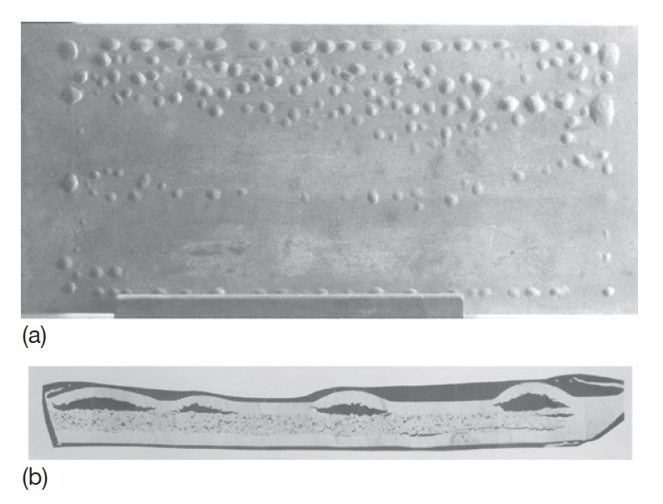
Blister Testing
In the typical blister test, the sample plate is held at a specified temperature for 30–60 min during each annealing step
The temperature at which blisters form is termed the ‘blister temperature’
Images of a U3Si2–Al dispersion fuel plate after a post-irradiation blister test at 450C

Slide 22
U-Si Blistering
For typical fuel particle loadings, miniature scale plates of U3Si2 and U3Si were blistered in the range of 515–530C
An increase in fuel loading dropped the blister temperature by about 75C
When boron is added, the blister threshold temperature decreases by about 100C, similar to what is observed in UAlx fuels
Boron is added as a burnable absorber in certain research reactor fuel designs as a means of flux/temperature balancing to avoid hot spots
The blister threshold temperature for U-Si intermetallic dispersion fuels is less sensitive both to burnup and to fuel volume loading than UAlx dispersion fuels

Slide 23
U-Si Summary
U3Si2 was qualified in 1988 under NUREG-1313 for use in research reactors
U3Si2 is presently considered the best qualified fuel in terms of uranium loading and performance for research and test reactors
U3Si is unsuitable for a plate-type geometry because of unstable swelling, but it is still considered for fuel rods
The ILs in U3Si2/Al are free of porosity formation at moderate burnups and the IL growth is considered reasonably slow
Both U3Si and U3Si2 are amorphized under irradiation, but have inherent differences in fission gas bubble growth
U3Si has excessive breakaway swelling, whereas U3Si2 has stable, albeit still large, swelling

Slide 24
RERTR to U-Mo
While U3Si2 was qualified, it was not suitable for higher temperature RTRs that extend to very high burnup
Failure to convert high-power research reactors using HEU to LEU U3Si2 resulted from the need for fuels of even higher uranium density
The fuel development effort has shifted to uranium–molybdenum alloys with Mo content ranging 6–10wt%, in both monolithic and dispersion fuel forms
Since 1997, the U–Mo alloys have been irradiation-tested, driven by US leadership
This program is now called the United States High Performance Research Reactor (USHPRR) Program
Similar programs work in conjunction with the USHPRR in Argentina, Canada, France, Belgium, and South Korea (used to also work with Russia)

Slide 25
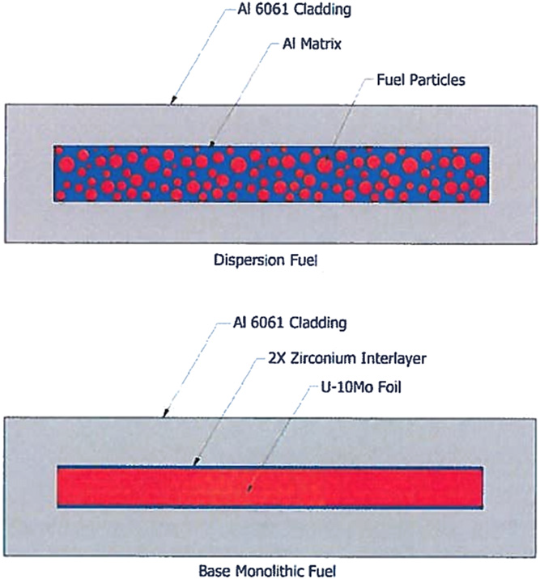
Two plate designs
Typical dispersion type fuel, U-Mo fuel particles dispersed in an Al matrix, Al cladding
Monolithic fuel foil, Zr interdiffusion barrier, Al cladding

Slide 26
U-Mo Fabrication
Dispersion fabrication is unique from monolithic fabrication
U-Mo dispersion fuels are fabricated in a similar manner to U-Si dispersion fuels
Both fragmentation and atomization processes can be applied
The U-Mo alloy is quite ductile, which poses problems for the fragmentation process
Alloys can be lightly oxidized to assist in fragmentation
The fragmented powders have more equiaxially shaped grains and a more homogeneous distribution of grains than the atomized powder fuel because there is no thermal process involved during fabrication
However, they are heavily cold-worked and contain a high concentration of dislocations which can polygonize and serve as nucleation sites for gas bubbles

Slide 27
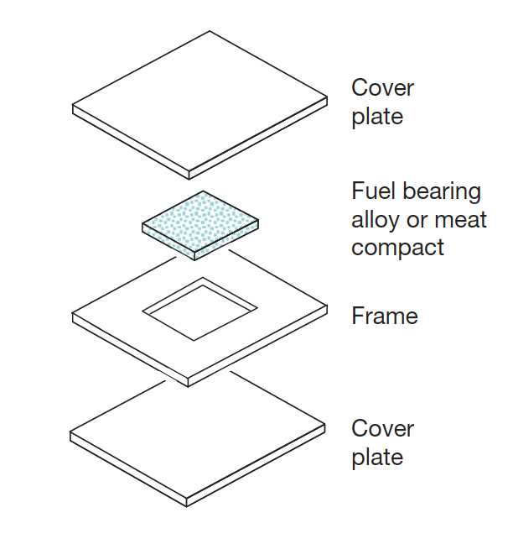
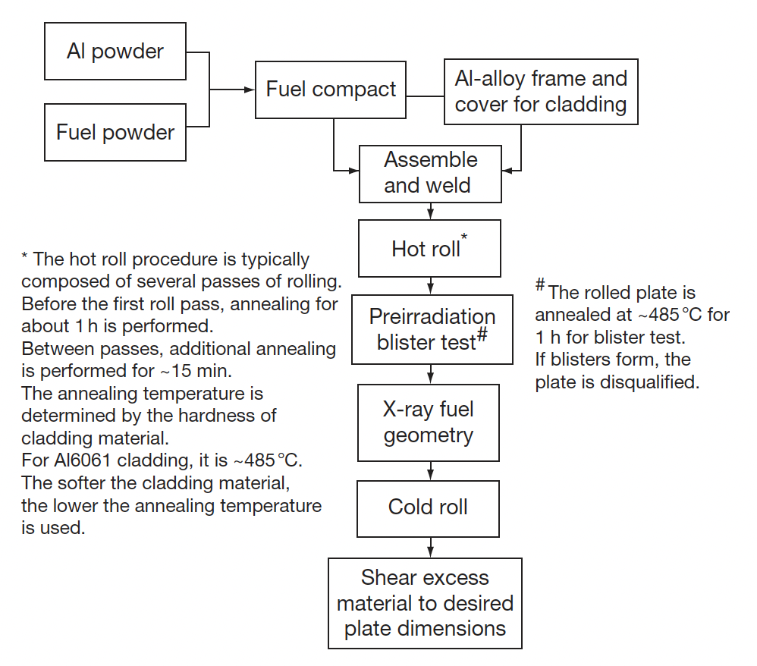
U-Mo Fabrication
The U–Mo fuel uses the same plate fabrication method as other U intermetallic fuels
However, the hot rolling procedure can have significant effects on the performance of the fuel
The thermal process changes particle characteristics and can enhance the interaction between the particles and the matrix

Slide 28
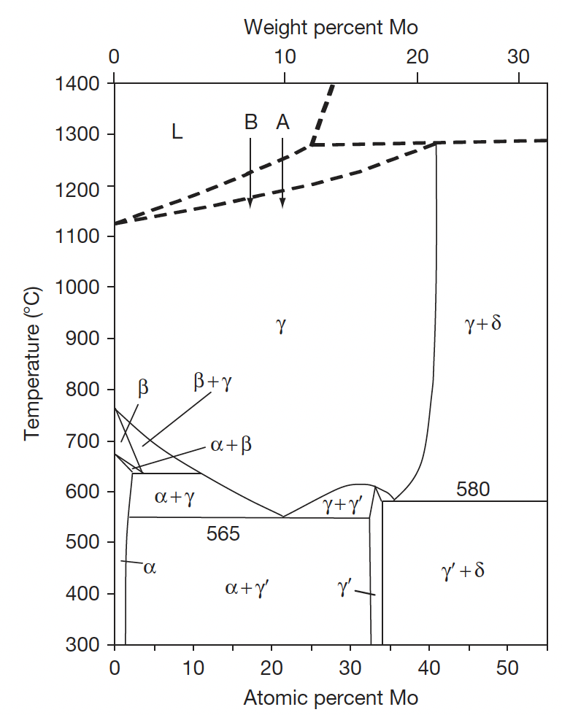
U-Mo
It was recognized early on in the development of fast reactor fuels that molybdenum is one of the strongest gamma-stabilizers of the transition-metal elements, even stronger than Zr, and that it enables alloys with U to have very high U density
A disadvantage of Mo as an alloying element is that it has higher neutron absorption cross sections than Si and Al, but not sufficiently significant to be problematic
The solubility of Mo extends to 22 wt% (or 41 at.%) in the gamma-phase, but it is limited to a few percent in the alpha and beta-phases

Slide 29
U-Mo Fabrication
The microstructure of the atomized powder consists of a ‘cellular’ solidification structure which is commonly found in rapidly cooled alloys that have a pronounced solidus–liquidus gap
Mo-rich phases solidify first upon cooling
As the cooling progresses, the solid phase volume increases, while, simultaneously, the Mo content in the solid phase decreases
If cooling is too rapid, Mo rich islands will form inside a network of a Mo lean matrix

Slide 30
U-Mo Phases
The gamma-phase undergoes a eutectoidal decomposition at 565C, transforming to the dual-phase mixture of the orthorhombic alpha-phase and the ordered tetragonal gamma’-phase which has the nominal stoichiometry of U2Mo
This transformation is slow when the molybdenum content is more than about 6 wt%, so a gamma-phase metastable U-Mo alloy with 6–12 wt% Mo can be obtained by quenching the alloy melt

Slide 31
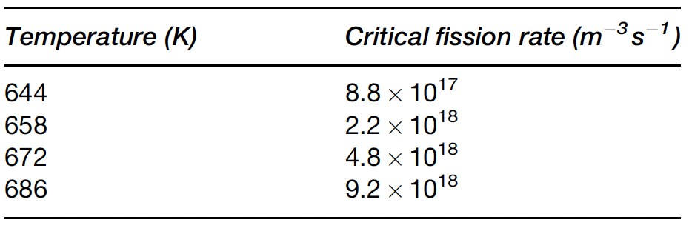
Gamma Stability
The radiation stability of U-Mo depends on its ability to retain the gamma phase
At research reactor temperatures, the gamma phase wants to transform into the alpha/gamma’ two phase system (based on the phase diagram)
Radiation counteracts the driving thermodynamics by disordering the gamma’ phase, retaining the gamma phase
The critical fission rate is the rate at which the minimum number of displacements that maintain the gamma-phase are in balance with the thermodynamic tendency to transform to the alpha/gamma’-phases

Slide 32
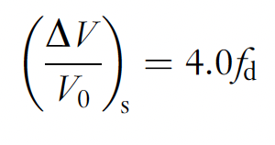
Fuel Swelling
Fuel swelling by solid fission products is also applicable for U-Mo fuels
The fuel swelling due to fission gases is unique in the U-Mo system
U-Mo swelling, specifically, swelling by gas bubble growth, is known to have two distinct rates: slow at low burnup and much faster at high burnup
The phenomenon underlying the transition is grain refinement or ‘recrystallization’ of the gamma-phase U-Mo
After this transition, gas bubble agglomeration accelerates, resulting in faster swelling

Slide 33
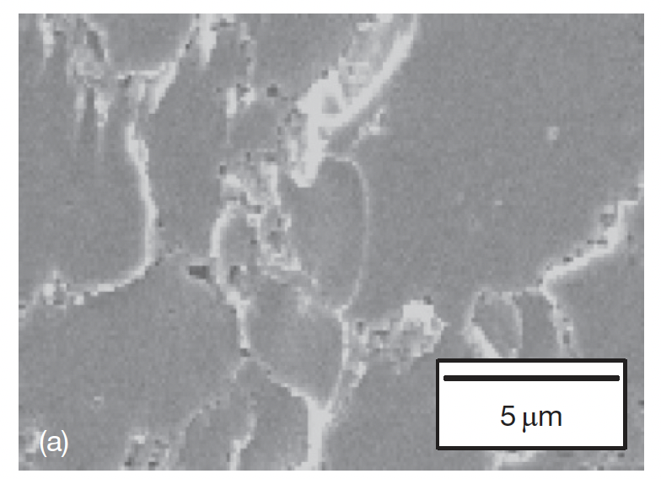
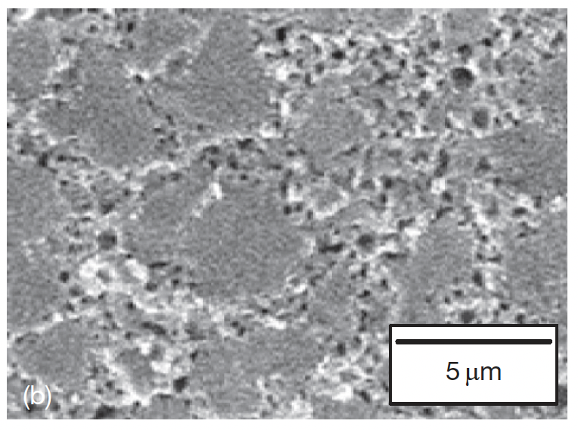
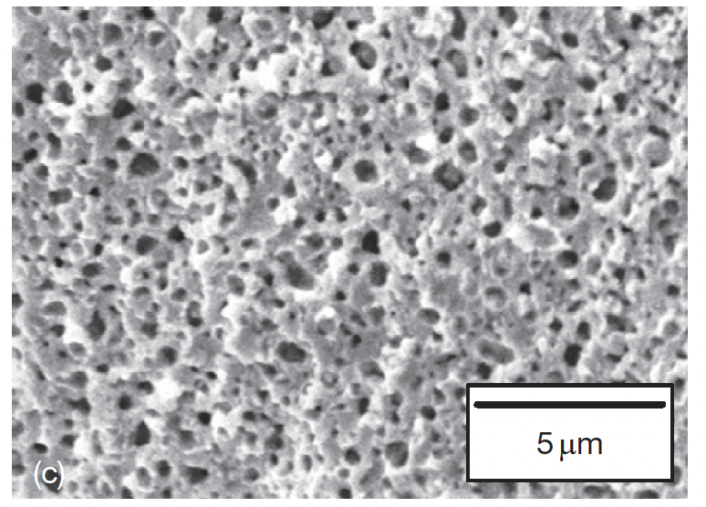
Recrystallization + Swelling
The evolution of fuel microstructure by fission gas bubble formation and growth is shown with three different burnups
In an SEM, fission gas bubbles first appear along grain boundaries, with no large bubbles in the fuel
35% BU
65% BU
80% BU

Slide 34
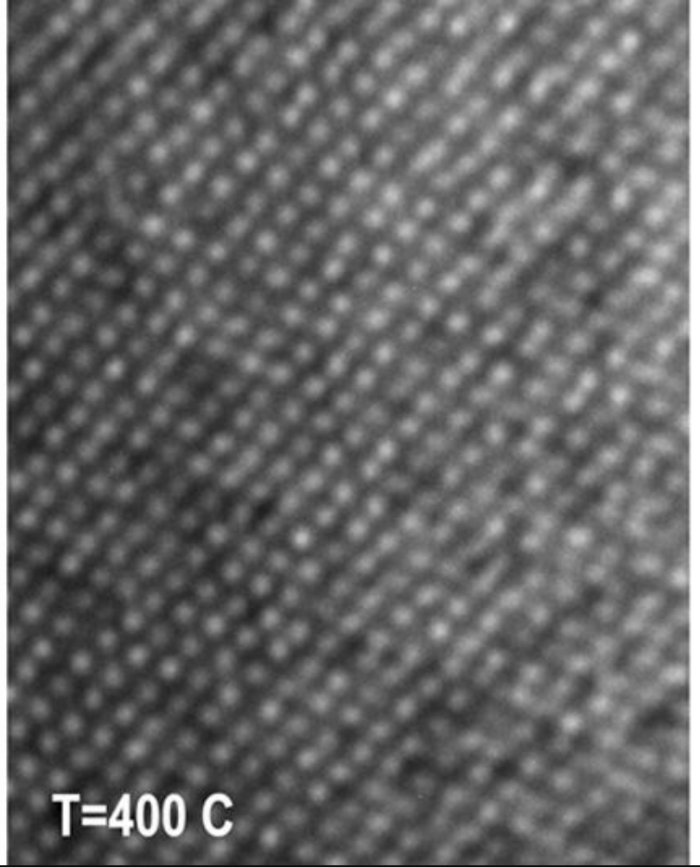


Fission Gas Superlattice
TEM analysis has identified in the low BU regime a fission gas superlattice of 2nm bubbles
As the bubbles are small, even though their number density is large, these bubbles are too small to produce much fuel volume increase
The Young-Laplace equation denotes a force balance, and the ideal gas law gives an approximation of the pressure
Thus, these small bubbles are highly pressurized and contain large amounts of gas

Slide 35
Recrystallization + Swelling
As burnup increases (2.5–3.5E27 fissions/m3), the bubble population increases in the grain boundaries and additional bubbles progressively appear at newly formed grain boundaries as grain refinement proceeds
At this stage, the average bubble size also increases with fission density as the number density increases, both of which increase the fuel swelling rate
35% BU
65% BU
80% BU

Slide 36
Recrystallization + Swelling
At higher burnup, large bubbles uniformly span the entire fuel cross section as the grain refinement is nearing completion
35% BU
65% BU
80% BU

